Slide 1
DID THAT
Some of our recent legislative successes:
Insured that Real Estate was exempt from Capital Gains Tax.
While other businesses were stalled on the sidelines, REALTORS® got back to work during the Covid-19 crisis in a way that was safe for you, and your clients.
REALTORS® were able to immediately clarify rules around property management and other affiliated services while other industries struggled to understand the regulations they were facing.
What would our industry look like without RPAC? It is not a concept we like to imagine for too long. In 2021 alone without RPAC and our advocacy efforts, business operations would look a lot different for REALTORS in Washington and across the country.
Notes:
Some of our recent legislative successes:
Insured that Real Estate was exempt from Capital Gains Tax.
While other businesses were stalled on the sidelines, REALTORS® got back to work during the Covid-19 crisis in a way that was safe for you, and your clients.
REALTORS® were able to immediately clarify rules around property management and other affiliated services while other industries struggled to understand the regulations they were facing.

Slide 2
DID THAT
Decreased the Real Estate Excise Tax by 15% on all sales under $500,000- putting nearly $1,000 back in your seller's pocket.
Exempted REALTORS® from a 20% increase in the B&O Tax you pay — putting $250–$500 back in the pocket of our members each year.
Protected your Independent Contractor Status.
Notes:
Decreased the Real Estate Excise Tax by 15% on all sales under $500,000- putting nearly $1,000 back in your seller's pocket.
Exempted REALTORS® from a 20% increase in the B&O Tax you pay — putting $250–$500 back in the pocket of our members each year.
Protected your Independent Contractor Status.

Slide 3
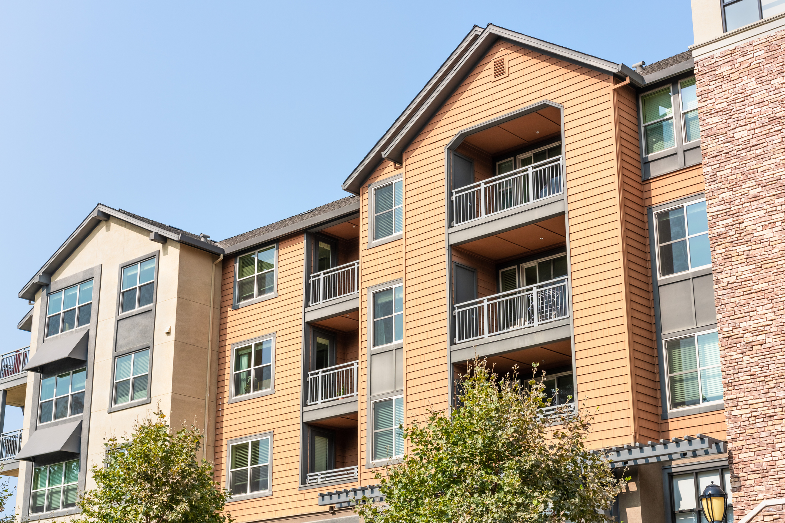
DID THAT
Beat back a bill that would have required any in house transactions to involve attorneys for both the seller and the buyer.
Reformed Condo Liability Laws so that more affordable condominiums can be built.
Passed a bill that encourages cities to allow responsible density — things like accessory dwelling units, duplexes and triplexes in single family zones and more.
Notes:
Beat back a bill that would have required any in house transactions to involve attorneys for both the seller and the buyer.
Reformed Condo Liability Laws so that more affordable condominiums can be built.
Passed a bill that encourages cities to allow responsible density — things like accessory dwelling units, duplexes and triplexes in single family zones and more.

