Slide 1
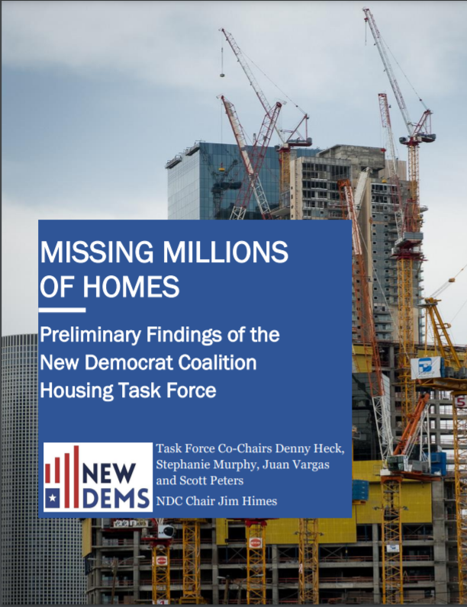
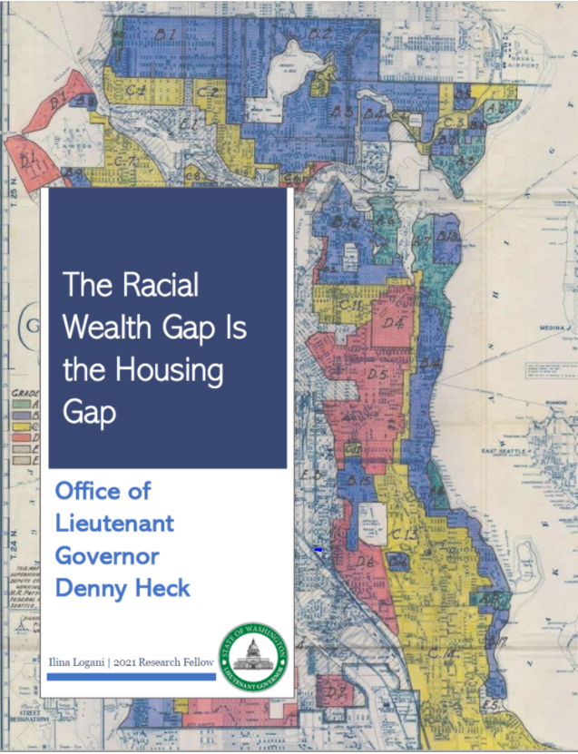
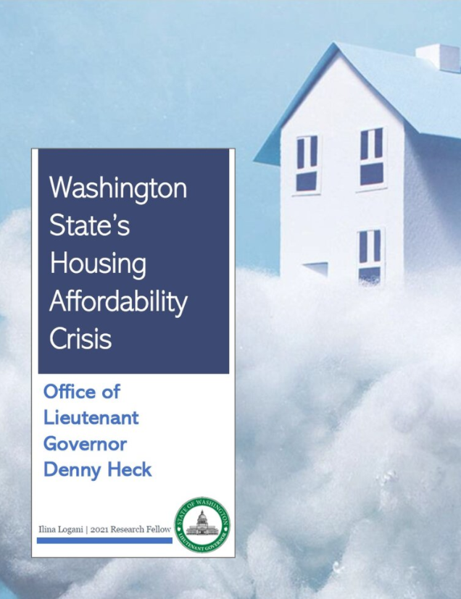
Housing is in Crisis

Slide 2
Washington State has the FEWEST housing units per household of ANY state
Washington State has the FEWEST housing units per household of ANY state

Slide 4
Washington State has the FEWEST housing units per household of ANY state
In 2020, Washington state median home prices were approximately $100,000 higher than the national average

Slide 5
Housing lies at the intersection of many problems
Slows growth
Harms environment
Reduces retirement security
Perpetuates homelessness
Increases racial disparity

Slide 6
The Racial Wealth Gap is the Housing Gap

Slide 8
Washington State Home Ownership 67% White |45% Hispanic | 31% Black
Net Worth Comparison
White Families: $188,000 | Black families: $24,100

Slide 9
Status Quo is not an option
Solution
Build more housing units of ALL kinds for ALL our neighbors

